Slide 1

Introduction to Robotics ME 639: Industrial Project Presentation 2
Project Title: Pill Picking Robot
Team Name: Bots
Team Members: Shardul, Prathamesh and Nikhil
Instructor: Prof. Harish PM
Teaching Assistant: Suraj Borate

Slide 2
Problem Statement:
“To design a gripping/picking mechanism to reliably pick one-and -only-one pill from an open cup containing only one type of pill of which type, size and weight will be known a-priori. ”
Industry name: Timetooth Technologies Pvt. Ltd.
Objectives:
Pick a pill of known dimensions from a cup
Only one pill has to be picked at a time
To design a control system for the picking mechanism
To design reliable gripping mechanism
1

Slide 3
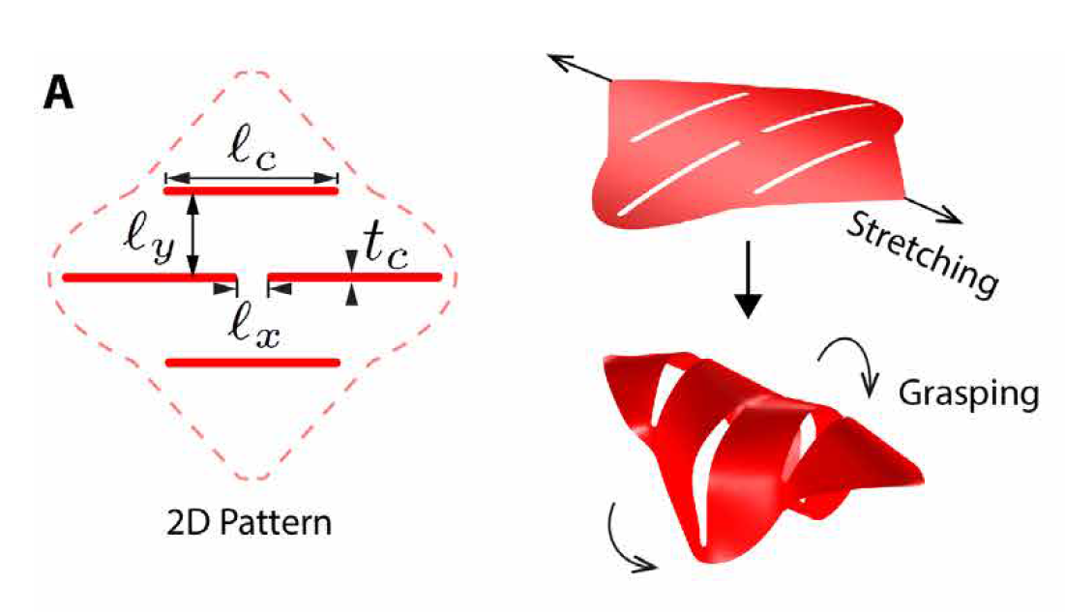
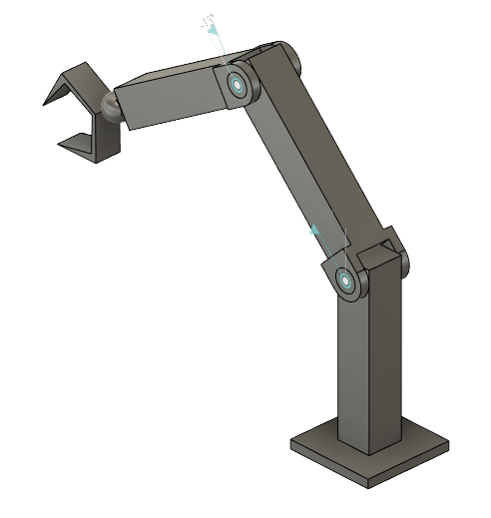
Brief Explanation:
Pill picking robot is the RRR robot having a new type of gripper at the end.
We have used a kirigami based model
Kirigami Gripper is made from PET material and is designed such that there is some curvature to the sheet and has 4 slits perpendicular to the direction of stretching forces as shown in figure 2.
This gripper is considered a soft robot as these robots operate with smaller forces needed for delicate and accurate grasping. Hence, this gripper would be able to gently pick pills of any shape without damaging them.
Overall the pill picking robot will that can hold and pick any object (like the pill) from an open cup.
Fig 1. Kirigami Gripper
2
Fig 2. PUMA robot

Slide 4
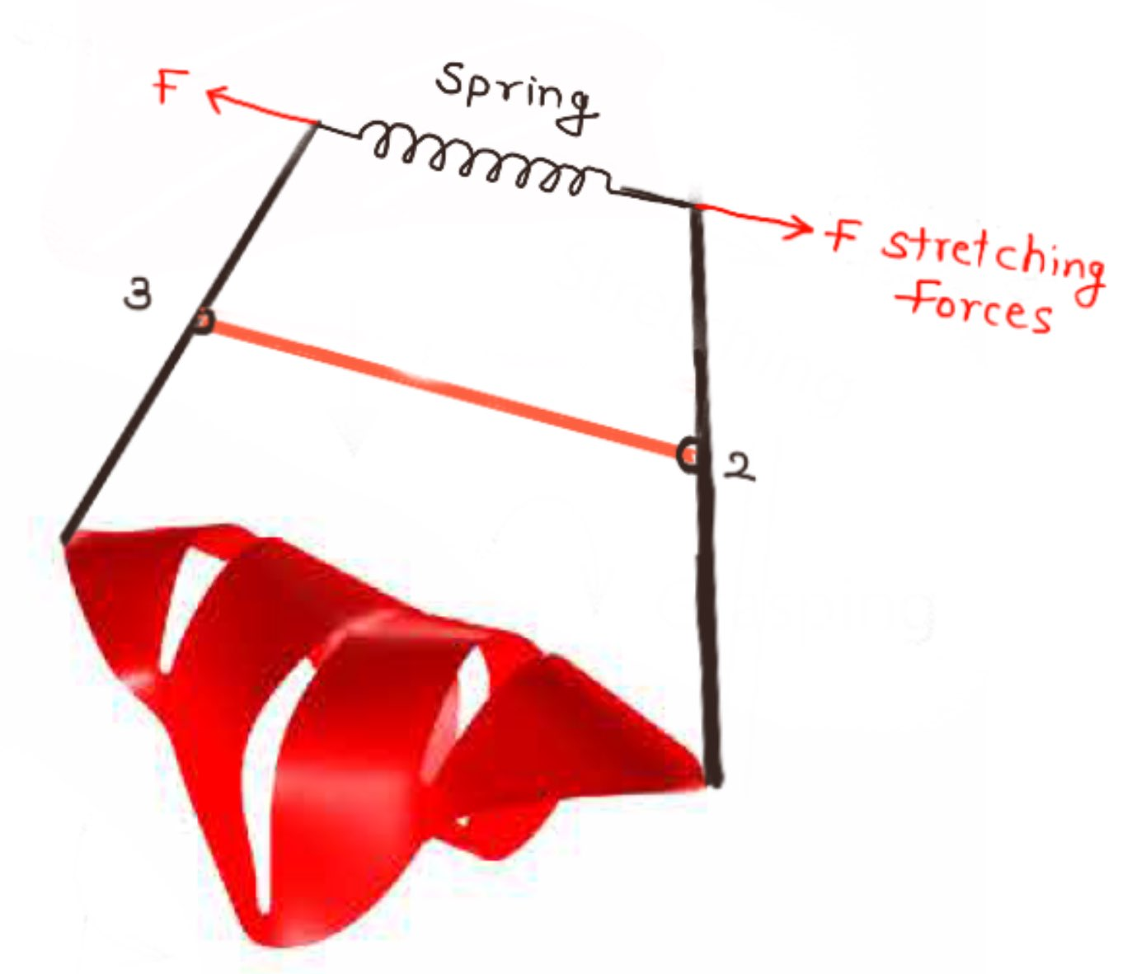
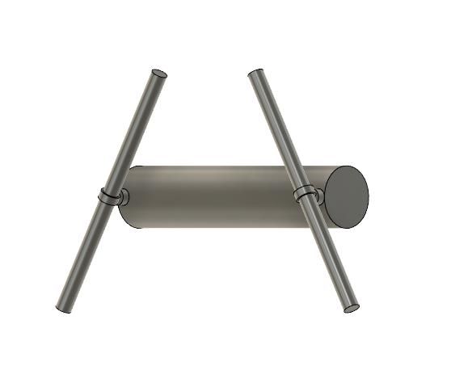
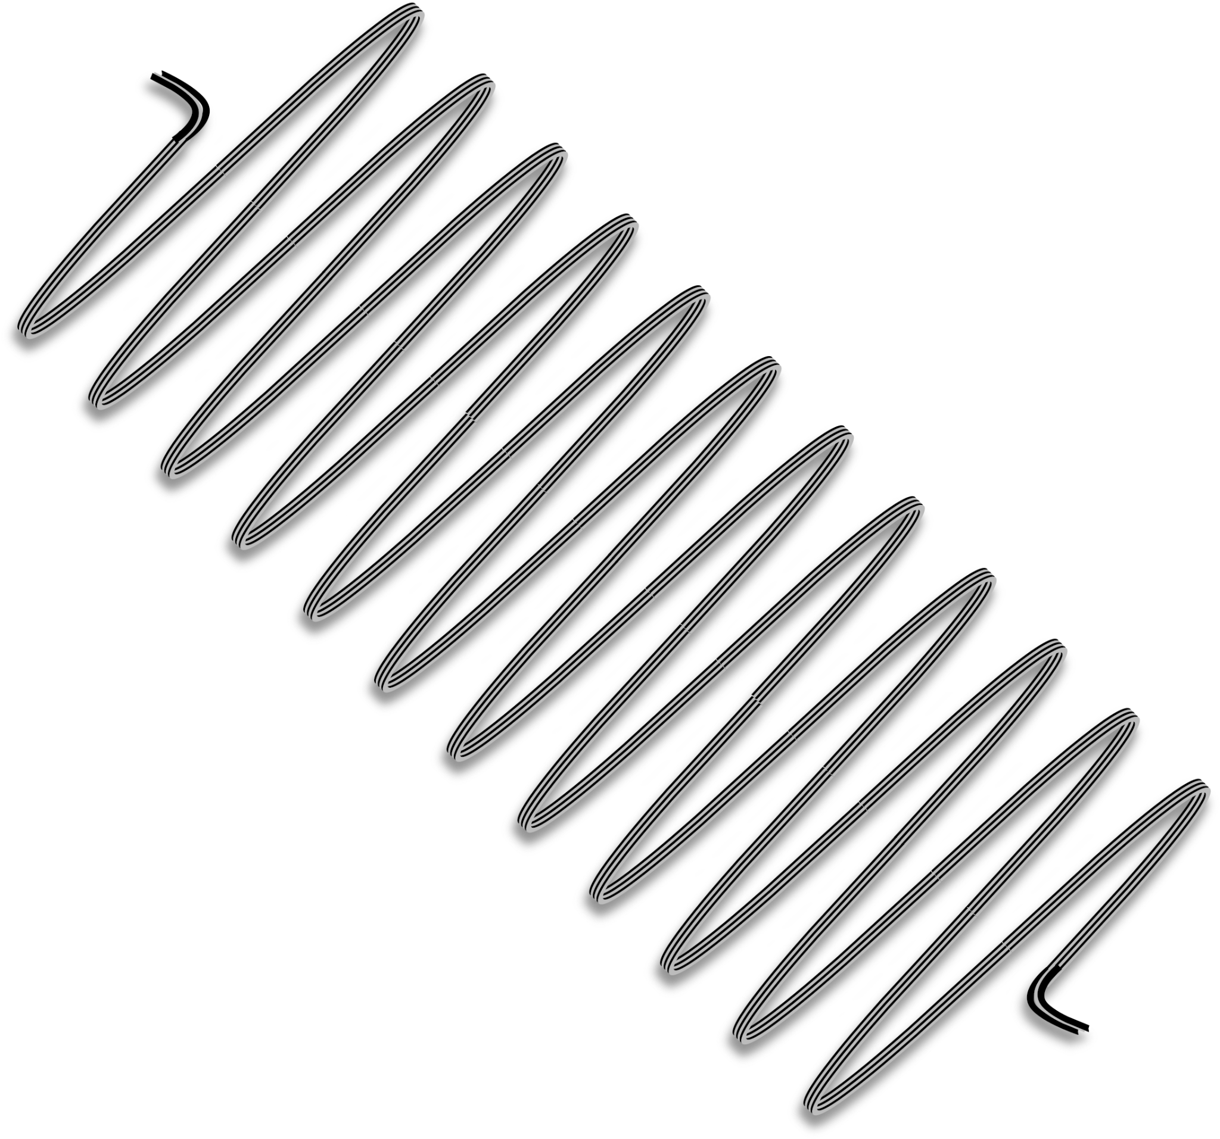
Gripper structure and actuation:
Appendages of kirigami gripper close when stretching forces are applied.
So, we have added an extra part to the gripper that will always rest the gripper in a closed state when no actuator force is applied to ensure that the pill stays in the gripper.
The mechanism consists of a simple H shaped frame, a spring on one side and the gripper on another side. In the natural state, spring pulls the two links closer resulting in the kirigami gripper closing. To open the gripper, the actuator will apply force opposite to the spring force
The actuator will be linear, can be either pressure actuated or a rack and pinion system.
Fig 3. Extended Gripper
3

Slide 5
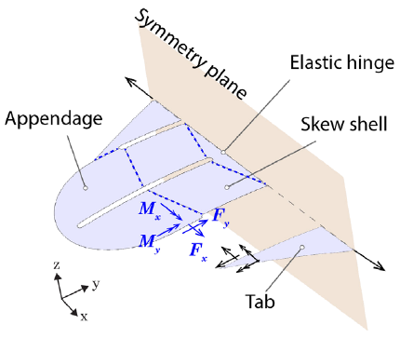
Force Analysis:
On the basis of deformations of kirigami shell, we decompose the kirigami shell has three structural components:
(i) two handling tabs
(ii) four skew shells (parallelogram shells)
(iii) Elastic hinge
(iv) two appendages
The diagram shows the forces and moments applied on the gripper.
A pulling force is applied on the tabs drifting them apart bending the gripper at he elastic hinge.
Due to this, the appendages come closer to grip the pill.
The skew shell separates apart creating a bend in the flaps of the appendages, helping to grip the pill with greater contact area.
Fig 4. Force Analysis
4

Slide 6
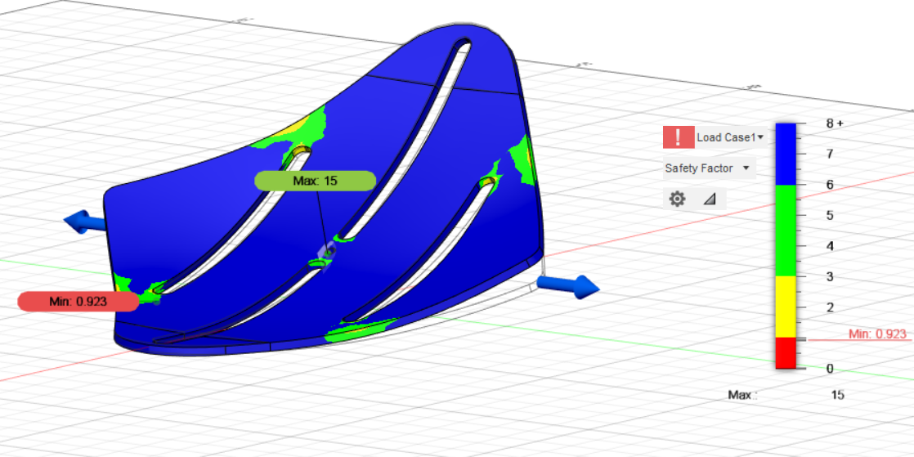

Slide 7
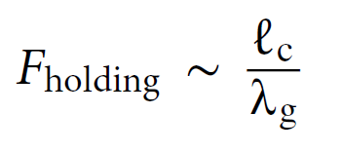
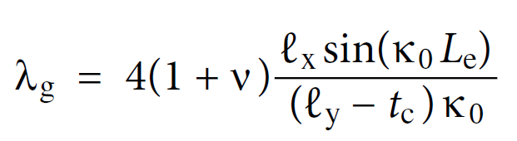
Related Equations:
Where,
F_{holding} = force exerted on the pill
L_{c} = length of the slits
𝝀_{g} = gripper characteristic length
Where,
𝝀_{g} = gripper characteristic length
𝛎 = Poisson’s ratio
L_{x} = distance between the slits in the x-direction
L_{y} = distance between the slits in the y-direction
ᴋ₀ = Curvature of the shell
6

Slide 8

Key Results:
7

Slide 9
Future Developments:
We have planned some further design and functional modifications for the project.
Adding flexible fin like enforcers on the inside of the gripper to ensure that only one pill is picked
Image processing functionality that detects the pill in a pile and identifies the longer side of the pill (orientation detection)
The gripper will be fitted with a sensor to detect the presence of the pill.
8

Slide 10
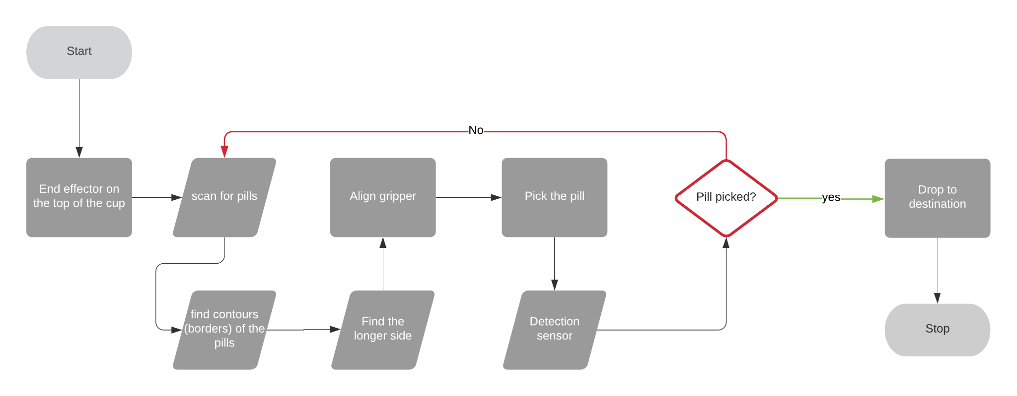
Robot Workflow:

Slide 11
Conclusions:
The material needs to be flexible but strong as the stress is more on the narrow parts of the gripper.
The size of the gripper has to be adjusted such that the gripper can only hold at most one pill at a time.
Opening of the cup has to be wider than normal size allowing the gripper to enter it without any hindrance.
The pills should be in a shallow pile for good performance.
10

Slide 12
References:
Yang, Yi & Vella, Katherine & Holmes, Douglas. (2021). Grasping with kirigami shells. Science Robotics. 6. eabd6426. 10.1126/scirobotics.abd6426.
11

